Slide 1
Review (chapter 9)

Slide 2
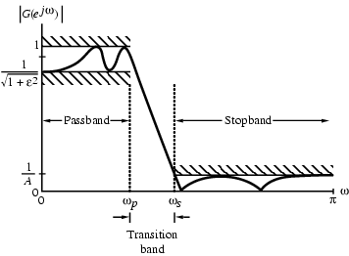
Digital Filter Specifications
Magnitude specifications may alternately be given in a normalized form as indicated below

Slide 3
Comparison of IIR and FIR filters：
IIR filter
FIR filter
h(n) is infinite length
h(n) is finite length
H(z) is a rational function of z⁻¹
H(z) is a polynomial in z⁻¹
Nonlinear phase
Exact linear phase
Can not be computed with FFT
Can be computed with FFT
With a recursive structure
In general, is not a recursive structure
With a lower order of N_{IIR}
With a considerably higher order of N_{FIR}
Can be designed from analog prototype filter
Designed with the aid of computer

Slide 4
Digital Filter Design: Basic Approaches
Most common approach to IIR filter design –
(1) Convert the digital filter specifications into an analog prototype lowpass filter specifications
(2) Determine the analog lowpass filter transfer function H_{a}(s)
(3) Transform H_{a}(s) into the desired digital transfer function G(z)

Slide 5
Butterworth Approximation
The magnitude-square response of an N-th order analog lowpass Butterworth filter is given by
First 2N - 1 derivatives of |H_{a}(jΩ)|² at Ω = 0 are equal to zero
The Butterworth lowpass filter thus is said to have a maximally-flat magnitude at Ω = 0

Slide 6
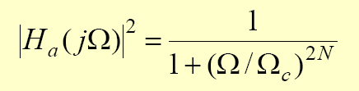
Analog Lowpass Filter Approximation
Butterworth Approximation
Chebyshev Approximation

Slide 7
Analog Lowpass Filter Approximation (cont.)
Elliptic Approximation

Slide 9
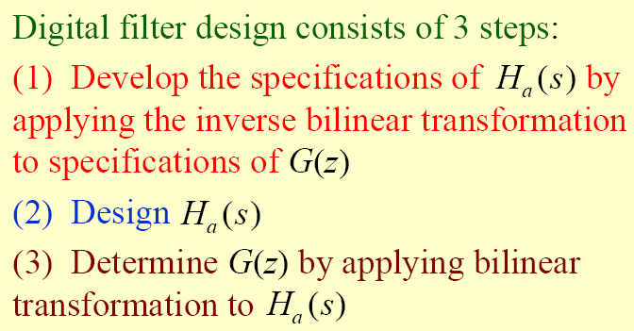

IIR Digital Filter Design

Slide 10
Frequency warping

Slide 11
Frequency warping (cont.)

Slide 12
Design of IIR Highpass, Bandpass,and Bandstop Digital Filters

